Slide 1
Gamification of Educational Applications in the Cloud: Current Trends, Challenges and Future Directions
Brooklyn Coulson (200375222)
Week 13
November 25, 2025
Cloud Computing and Applications (ENSE-885BD)

Slide 2
Agenda
Introduction
Goal of the Study
Research Methodology
Research Methodology Outcomes
Taxonomy
State of the Art
Conclusion and Future Research Directions

Slide 3



Introduction
There are many ways education service providers may benefit from using cloud computing services
Are there different ways to improve the experience of learning from the student perspective?
Gamification can be a way to engage and motivate youth to learn

Slide 4


Goal of the Study
To understand how education service providers are currently utilizing cloud computing services
To understand how other industries are using gamification concepts in their cloud computing systems
What currently exists for gamification within educational applications in the cloud
To identify research gaps with respect to gamification within educational applications hosted in the cloud

Slide 5
Research Methodology
Research Questions
What are various education applications hosted in cloud computing systems?
What are the challenges being faced by education service providers in their cloud computing systems?
What are various gamified applications hosted in educational settings?
What are the challenges being faced by industries using gamification in their cloud computing systems?
What advancements have been made in cloud-based gamification in education?
Search Strings:
applications, "cloud computing education"
applications challenges, "cloud computing education"
gamification education, "cloud computing"
gamification challenges education, "cloud computing"

Slide 6
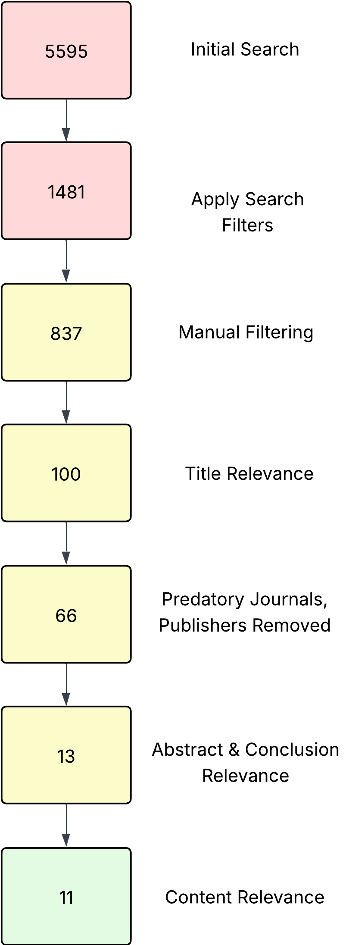
Research Methodology
Search Strings filtering
applications, "cloud computing education", -IOT, -"Internet of Things"
applications challenges, "cloud computing education", -IOT, -"Internet of Things"
gamification education, OR HEI, OR "higher education", OR school, "cloud computing", -IOT, -"Internet of Things"
gamification challenges education, OR higher, OR HEI, OR school, "cloud computing", -IOT, -"Internet of Things", -"big data", -"big data analytics", -"AI"
Date range: 2016-2025
Manual Filtering
Previously cited
Redacted
Non-English papers
Duplications
Books
Predatory Journals and Publishers
Baell's List
Publisher websites
Google search in general
Notes:
Search filters:
Date –1484
OR and exclusions -4111
Manual filter:
Citation –57
Redacted -10
Non-english -68
Duplicate -1320
Book 26

Slide 7
Research Methodology Outcomes

Slide 8
Research Methodology Outcomes
Notes:
Covid 2020-2022

Slide 9
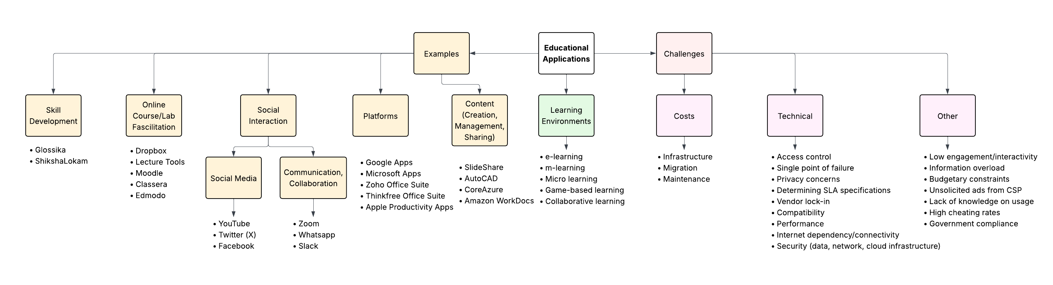
Taxonomy – Educational Applications

Slide 10
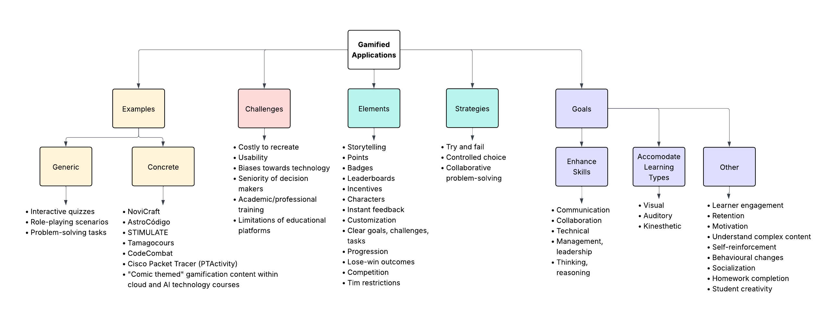
Taxonomy – Gamified Applications

Slide 11
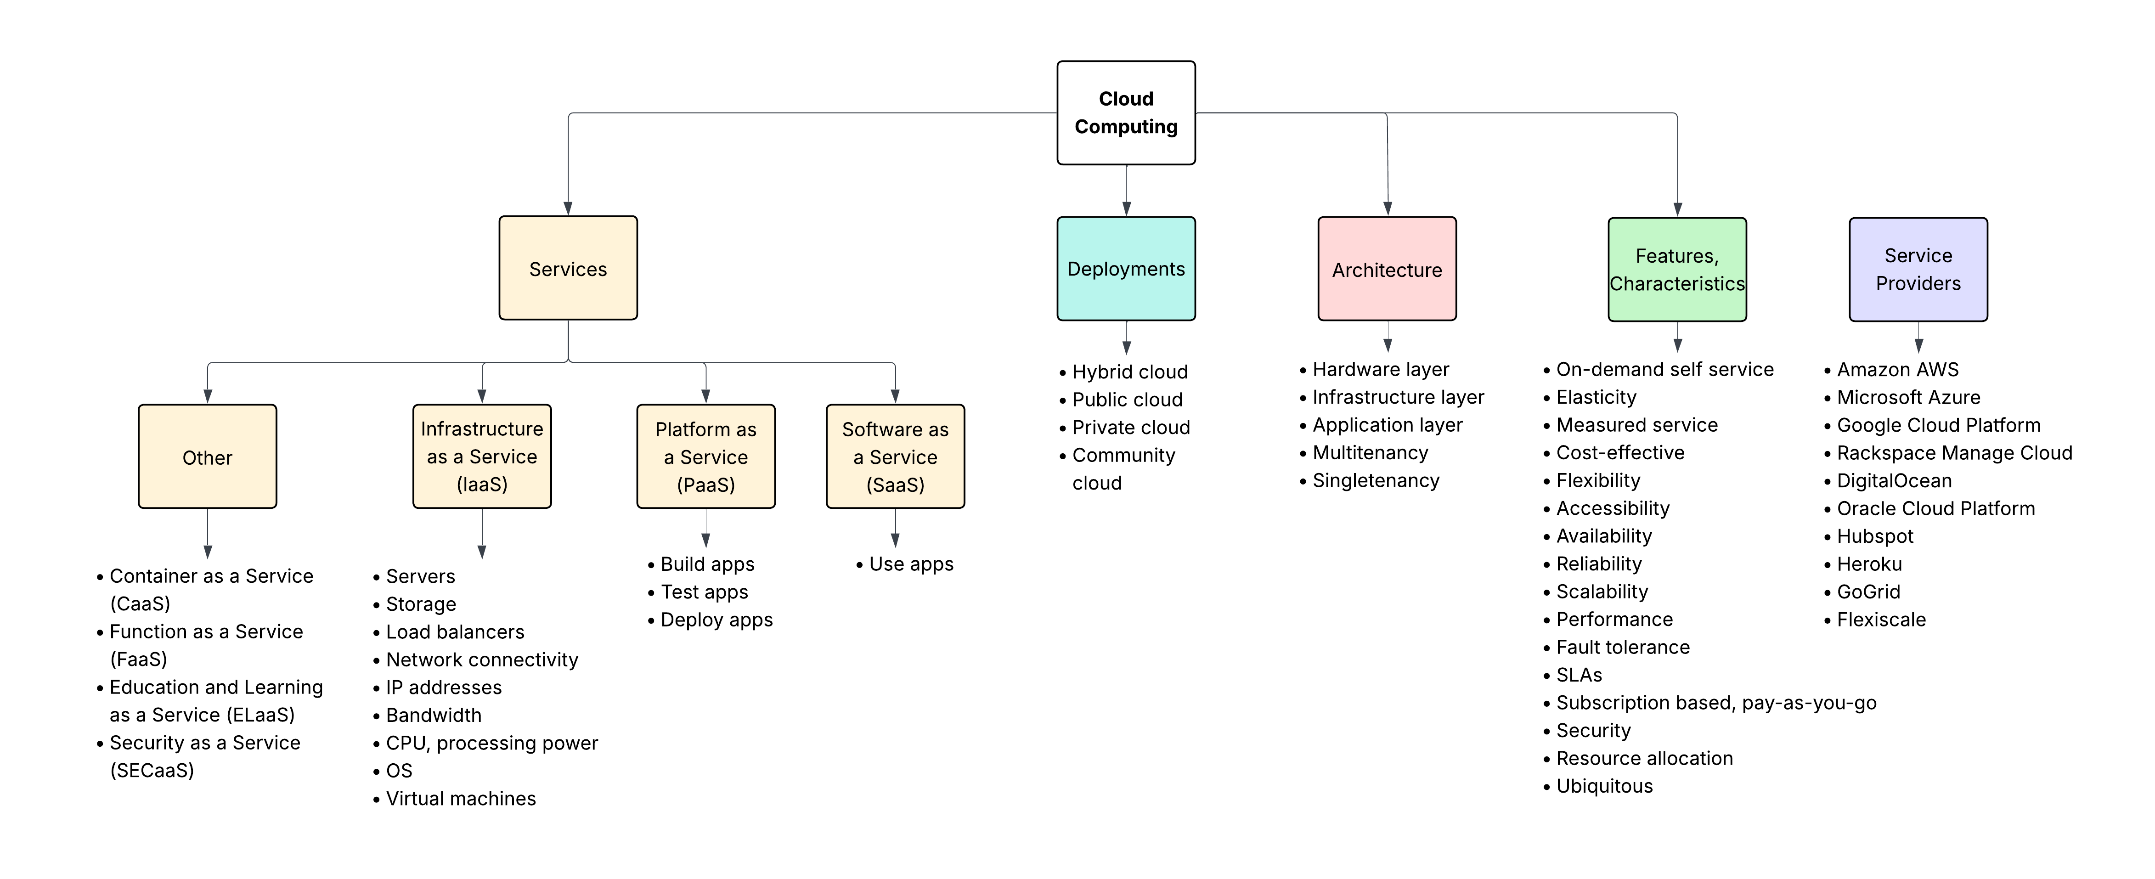
Taxonomy – Cloud Computing
Notes:
ELaaS - cloud services provided to educational institutions as a subscription basis.

Slide 12
State of the Art
Research Question Addressed | Research Paper Summarized
What are various education applications hosted in cloud computing systems? | Sagale et al. Application of Cloud Computing in an Education Sector through Education and Learning as a Service and its Cost Benefit Analysis.
What are the challenges being faced by education service providers in their cloud computing systems? | Bangkong et al. Overcoming the Challenges of Implementing Cloud Computing in Higher Education.
What are various gamified applications hosted in educational settings? | Tomičić et al. A Conceptual Network Analysis of Gamification Practices in Primary and Secondary Education.
What are the challenges being faced by industries using gamification in their cloud computing systems? | Sandí-Delgado et al. Acceptance of Serious Games to Develop Digital Competencies in Higher Education.
What advancements have been made in cloud-based gamification in education? | Xu et al. Design and Evaluation of the Makahiki Open Source Serious Game Framework for Sustainability Education.

Slide 13
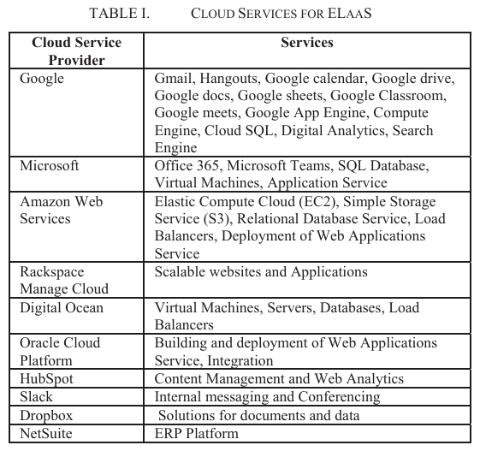
What are various education applications hosted in cloud computing systems?
Sagale et al. Application of Cloud Computing in an Education Sector through Education and Learning as a Service and its Cost Benefit Analysis.
What's been done?
The paper highlights some challenges in education, and benefits of cloud computing at a high level. Describes some applications of cloud computing in higher education (virtualized classrooms, cost benefit, security & encryption, scalability of services, innovation, expanding horizon). Presents some specific cloud service examples. Provides four brief case studies (Glossika, ShikshaLokam, CoreAzure, Montash University).
Notes:
Challenges (2023):
More focused on socio-economic challenges of HEI in developing countries, can be tough to bring children into classrooms
How Covid intensified this
Touch on current infrastructure not being able to support online education
Electricity, connectivity, device availability, learner adaptability
Cloud computing benefits:
Accessibility, Data security, cost benefit, disaster recovery, flexibility, easy upgrade, scalability
General applications of CC:
Virtualized classrooms
Remote teachers can reduce overhead cost
Online infrastructure can reduce lab/physical classroom accommodation cost
Students can access content anytime, anywhere
Cost benefit
Maintenance and management of hardware no longer a cost concern
Students can access materials posted online like textbooks
Security & encryption
Secure and encrypted environment to protect data in the cloud
Scalability of services
Emphasizes is the most useful
Scale up resources during high traffic periods
Scale down during low traffic periods to not waste resources
Innovation
Applications, tools, and features through the cloud to enhance student learning experiences
Expanding horizon
Students can pursue courses offered in other parts of the world due to remote access
Glossika
Educational tech firm in Taiwan, proposed application to train people in 148 countries to speak 60+ languages (like DuoLingo)
Learning platform built using
Amazon RDS (Amazon Relational Database) scalable, easy to use DB in cloud
Amazon ElastiCache (managed, scalable In-memory cache)
and CloudFront from AWS (edge websites)
Stores thousands of sentences and their translations in audio/textual format
Scaled infrastructure to accommodate 25M+ users, takes advantage of automation
ShikshaLokam
Nongovernmental org working in India's education sector to fill resource gaps
Provides open, digital infrastructure to help stakeholders develop leadership skills
Works with 10 NGOs in 8 states providing context-based self learning
Built using
Open-source Sunbird datacentre infrastructure management
Amazon EC2 (Elastic Compute Cloud) (scalable computing power)
Amazon ECS (Elastic Container Service) (create, manage, delete containers for workloads)
Resource utilization cost is reduce by 20% due to
AWS Cost Explorer
Amazon CloudWatch
CoreAzure
Founded 2014, leading certified partner of Microsoft (hence Azure portion of the name)
Intention to maximize output from Microsoft technologies to customers
Helps UK government with cloud migrations projects
Help UK universities move to the cloud to avoid aging infrastructure
Sheffield Hallam University and University of Plymouth migrated to the cloud using
IaaS lift and shift approach
Added:
Next gen firewalls
Sentinel (collect, analyze, respond to data to understand security environment including threats and issues)
Azure Security Center (visibility, recommendations, threat protection; security management tool)
Montash University
One of the largest Australian universities
Implemented multi-cloud model using both AWS and Azure
Uses
ONTAP's data replication features
Cloud Manager (single click, full stack provisioning)
This cloud storage configuration has seen a 25% reduction in storage space and has enhanced their performance

Slide 14
What are various education applications hosted in cloud computing systems?
Sagale et al. Application of Cloud Computing in an Education Sector through Education and Learning as a Service and its Cost Benefit Analysis.
Limitations of the work | Proposed future research
Did not state any limitations of their own work. OBSERVATION: The benefits section was a little weak and did not provide a good case/argument for the adoption of cloud computing within the education sector. | Future studies to focus on implementing their proposed Education and Learning as a Service (ELaaS) model at an institution level by applying decision making matrix parameters.

Slide 15
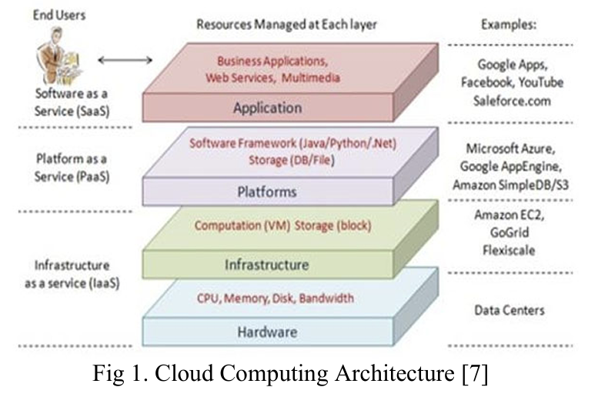
What are the challenges being faced by education service providers in their cloud computing systems?
Bangkong et al. Overcoming the Challenges of Implementing Cloud Computing in Higher Education.
What's been done?
An overview of research on cloud computing within the education sector. Background provided on cloud computing services and deployment model is given. A critical analysis is done on major Cloud Service Providers (CSPs) with respect to education related cloud features. The benefits and challenges of cloud computing is also highlighted. Primary challenges discussed: Access Control, Network Security, Data Security, Cloud Infrastructure.
Notes:
Overview:
Mentions things and relates back to cloud computing
Students accessing internet anywhere, anytime (no limitations) => accessibility
Institutes owning/managing their own infrastructure => taken care of by CSP
Data being stored is safe in the cloud => security
Deployability and scalability of resources in the cloud
Cloud model includes 5 essential characteristics:
On-demand self-service (provision computer resources automatically w/o CSP interaction)
Resource pooling (CSP efficiently share resources that are centrally accessible)
Measured service (Monitoring, regulating, reporting resource utilization for management/optimization)
Broad network access (access via any device/platform, os)
Rapid elasticity (Scale resources inward or outward according to traffic/usage)
4 Key elements to successful cloud implementation:
Security (could be exploited by hackers)
Performance (could be reduced according to geo location of resources)
Government compliance (regulations may not fully support cloud computing)
Financial (cloud computing may be cheaper up front, but could cost more long-term depending on set up)
Background:
Cloud computing architecture (application layer, platform layer, infrastructure layer, hardware layer)
Cloud service models (SaaS, PaaS, IaaS)
Cloud deployment models (Public, Private, Community, Hybrid)
Education specific cloud features:
Virtual classroom (no physical bounds, collaboration on courses, trainers/students from elsewhere, virtual exams)
Cost savings (textbooks/materials online, automation of tasks reduces admin costs, pay as you go for infrastructure)
Accessibility (physical location access, device compatibility)
Scalability (busy/slow time resource utilization)
Secure data storage (VPN to access)
Hardware reqs (accessing material, using applications)
Automation (no staff to maintain systems)
Backup and Recovery (doc recovery in app, CSP manages)
Efficiency (mail providers)
Crit analysis
Microsoft Azure
Services for all platforms (IaaS, PaaS, SaaS)
Hosting, application development, tools for productivity
Azure can scale up and down
Super Hyper-V is org-specific private cloud platform (orgs manage compliance, costs, security within platform)
Also provides Economic and Enterprise private clouds specific to those industries
Microsoft Office 365
Amazon Web Services
Software
(search, purchase, use from AWS Marketplace)
Compute
Amazon Elastic MapReduce (handles huge quantities of data)
EC2 (Elastic Compute Cloud) (scalable computing power)
Elastic Load Balancing (auto distribution of traffic)
Autoscaling (add/remove instances according to traffic)
Content Delivery
Amazon CloudFront (edge websites)
Storage
AWS Storage Gateway
Amazon Glacier
S3 (Amazon Simple Storage Service)
AWS Import/Export
Amazon Elastic Block Storage
Deployment & Management
AWS Direct Connect
VPC (Amazon Virtual Private Cloud)
Amazon Route S3
Application Services
SES (Amazon Simple Email Service)
SQS (Amazon Simple Queue Services)
SNS (Amazon Simple Notification System)
Amazon Simple Workflow Service
Amazon CloudSearch
Workforce
Amazon Mechanical Turk (hire workers worldwide)
Database
Amazon Elastic Cache (scalable In-memory cache)
Amazon SimpleDB (NoSQL DB for small data)
Amazon DynamoDB (scalable high-performance NoSQL DB)
RDS (Amazon Relational Database) scalable, easy to use DB in cloud
Google Apps for Education
Collab tools for teachers/students to use
Presentations, projects, papers in the cloud
Google+
Google Docs
Google Calendar
Google Groups
Google Drive
Gmail
Primary goal to improve teaching/learning
Create course websites to courses (Google Sites)
Main factors for considerations (price, storage, reliability, range of services)
Challenges
Access Control
Authentication, identification, authorization
Weak authentication can lead to unwanted access of shared data or services
Privacy must be protected through authorization
Best intervention strategies
VPN technology
Next Generation Firewalls
Privileged Access Management
Network Security
Concerns with security through the network when transmitting/transferring data to the cloud
Common network-based attacks
Man-in-the-middle
DoS
DDOS
Packet sniffing
IP spoofing
Port scanning
Session hijacking
Phishing
Vulnerabilities highlighted -> hacking and intrusion
Strong security methods:
Transport Layer Security (TLS) Protocol
Secure Socket Layer (SSL) Protocol
Appropriate auditable access privileges
Firewall router rules
Data Security
Some institutes prefer storing important data onsite in local repos
Cloud data states with security concerns
Data-at-Rest
Data in the cloud (ensure it hasn't been altered by unauthorized users)
Data-in-Transit
Data could be lost or leaked during transit
Inadequate encryption techniques and weak keys are a risk with this
Cloud Infrastructure
Shared environment of hardware amongst different cloud users could pose security issues
VM protection is a security concern b/c several VMs share the hardware, making it hard to place hardware protection devices like firewalls b/w them
Hard to track attacks from user perspective as VMs are created/deleted/migrated constantly, this makes it hard to track traffic and establish is an attack is happening
Common attacks:
VM Rollback Attacks
Botnets
Phishing
Cross-VM Side Channels
Malware Injection
DoS
Theft-of-Service

Slide 16
What are the challenges being faced by education service providers in their cloud computing systems?
Bangkong et al. Overcoming the Challenges of Implementing Cloud Computing in Higher Education.
Limitations of the work | Proposed future research
Did not highlight any specific limitations. OBSERVATION: Did not approach the analysis of the critical review of each CSP the same way, making it hard to compare features. | No further research was proposed. Suggested educational institutions to address the obstacles (challenges) discussed in the paper when implementing cloud computing to ensure proper/optimal tech utilization to enhance the quality of education.

Slide 17
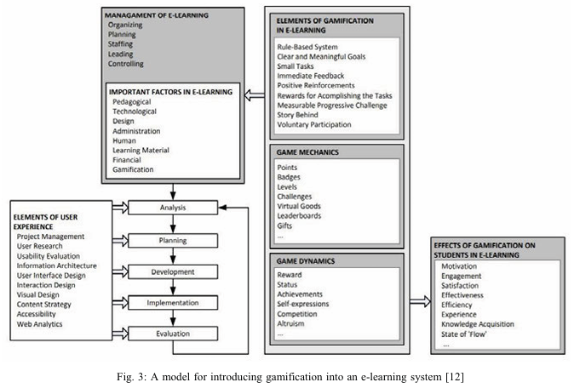
What are various gamified applications hosted in educational settings?
Tomičić et al. A Conceptual Network Analysis of Gamification Practices in Primary and Secondary Education.
What's been done?
An analysis of gamification elements that are used within educational systems (points, badges, levels, leaderboards, goals, challenges, customization, feedback, competition, etc.). An analysis on what gamification elements can be applied to educational contexts. High level examples are provided in terms of educational contexts.
Notes:
Gamification elements:
Principles of gamification design
Goals and challenges
Customization
Progress monitoring and visible status
Feedback
Competition and social aspects
Content unlocking
Storytelling
Freedom of choice and failure
Game mechanics
Points
Badges
Levels
Flowcharts
Leaderboards
Virtual currencies
Avatars
General applications
7 primary goals of gamification
Mastering skills, enhancing competencies
Value add challenges
Simpler/more engaging learning process
Improving learning and maximizing knowledge acquisition
Behavioural changes through rewards and punishments
Socialization through group learning
Gamification as a means to guide motivation and coping with learning disabilities
Examples (total of 11 examples, a number of them weak)
Classcraft
Inspired by RPG games
Available as a web and mobile app
Allows management and collaboration among students
Used at all levels of education around the world
Includes
Player role selection
Avatars
Health and action points
Random events
Students progress through levels by solving quests (answering questions) and gaining powers (skip a question, phone a friend)
There's an analytical backend component that allows teachers to observe and analyse student behaviour/progression
CodeCombat
Web app that allows you to learn coding by doing within an RPG environment
Players select a character, and must write code to perform tasks and accomplish goals
Includes
Progress tracking
Damage and health levels
Speed and weapons
Clan formation
Content unlocking
Missions
Rewards
Virtual currencies
Brighton University's "Who is herring Hale?"
Alternate reality game to assist new students in orientation and adjusting to uni life, meant to foster inclusion
Included
Points and prizes
10 tasks, one per week
Storytelling
Assignments based on online and physical services
Hidden clues, codes and encrypted content
The format of the game was generally disliked
For those who did enjoy, the format proved to be effective
Computer Games Course
Made use of elements such as goals, scoreboards, "big boss fights", randomness within the game
Wel received by students, especially the final boss fight which acted as the "final exam"
Students did not like that they could not choose their own teams, and were instead put into random groups
Gamifying technically challenging courses at a Dutch technical university
Over the course of 3 years, 450 participants
Challenging courses like computer organization and cloud computing
Gamification correlated with college pass rates, participation in voluntary activities and challenging tasks
Overall, increased interaction and increased level of focus on course design
Game elements in a graduate course
Added game elements to a course and compared results to the same course that was used as a control
Grades
Levels
Scoreboards
Challenges
Badges
Resulted in increased attendance, online participation, proactive behaviours, and studying of course materials
Students reported increased motivation, interest, and the course was easier to learn
Rochester Institute of Technology's School of Interactive Games and Media
Developed game system called "Just Press Play"
Helped students actively engage in the learning environment and foster social behaviour
Students from all ages connected, attended workshops, and suggested ideas for course development
Overall increased engagement from students in University life, and academic and social success

Slide 18
What are various gamified applications hosted in educational settings?
Tomičić et al. A Conceptual Network Analysis of Gamification Practices in Primary and Secondary Education.
Limitations of the work | Proposed future research
Lack of research efforts addressing effectiveness of using game elements in educational environments. Many theoretical papers on gamification in education, limited empirical papers on the topic. | Additional research efforts towards the development of software tools supporting gamification in an educational context.

Slide 19
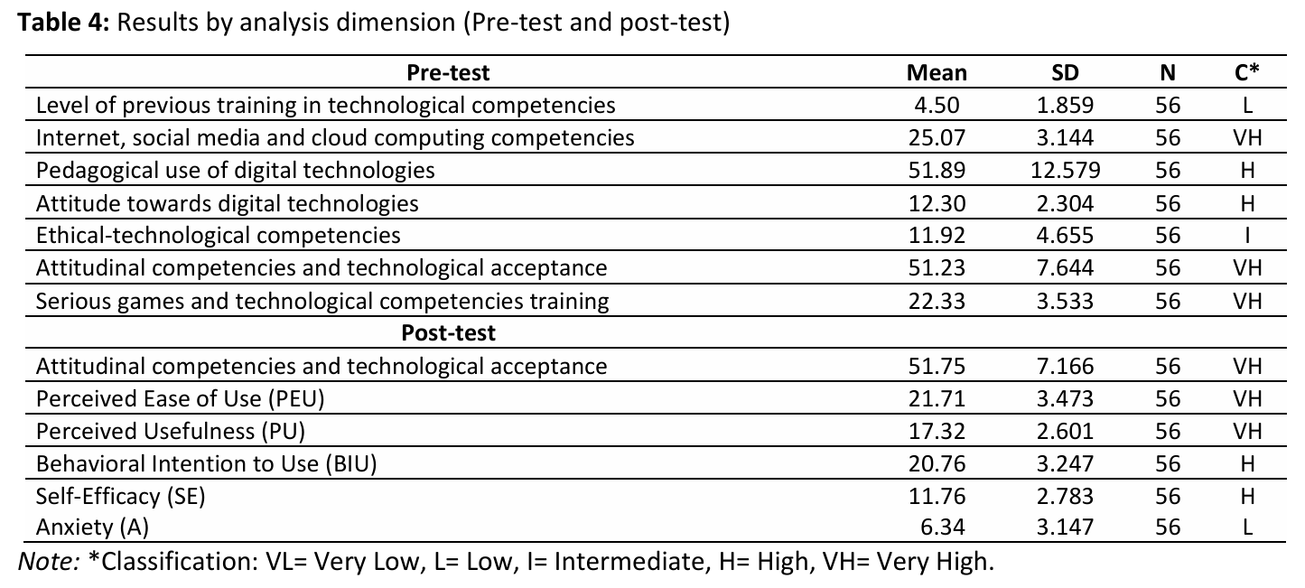
What are the challenges being faced by industries using gamification in their cloud computing systems?
Sandí-Delgado et al. Acceptance of Serious Games to Develop Digital Competencies in Higher Education.
What's been done?
Literature review of the importance of using serious games in the education domain and a theoretical background on the TAM model for measuring acceptance and its influences (in relation to serious games). Case study using "Astrocódigo" to determine the acceptance by academics and what influenced their decision most. A series of questionnaires and interviews took place during the Pre-Test, Intermediate Evaluation, and Post-Test phases.
Notes:
Lit Review:
Overall discussed different games that have been analyzed to enhance learning, but not with respect to tech acceptance within education
STIMULATE (Science Training Immersive Modules for University Learning Around Teacher Education)
- advance science teacher prep/development
Analyzed usability/effectiveness of initial version w/ 31 teachers, results = positive learning gains
Cisco Packet Tracer – train/empower a network of config skills for all audiences
Lead to Moodle plugin "PTActivity"
offering improvement opportunity for tech skill training process, collab work, learning experience
NoviCraft – improve work skils (comms, collab, tech, management, leadership)
Boosts motivation, interest, commitment of players
Tamagocours – enhance skills req to articulate integration of digital tech and internet in training processes
81 participants, developed different game strategies to obtain certificate (try and error, controlled choice, collaborative game)
Theoretical background:
TAM (Technology Acceptance Model)
Way to measure acceptance level of tech with respect to perceived usefulness and ease of use
TAM2 focuses more on usefulness, TAM3 on ease of use
Gave several examples on it being used, but not with respect to serious games
Astrocódigo:
Serious game where problems are solved algorithmically and explore concepts like hardware and software
Aim is to help structured problem solving, promote algorithmic thought, abstraction capabilities, and using digital tech to plan actions
6 customized scenarios of increasing difficulty
Specific task of the story: Programming a virtual robot to recover some pieces from a ship
Involved playing the game during 150 min sessions consisting of 4-12 participants each
Pre-Test:
Questionnaire to gauge players current digital competency status, opinions related to Information and Communication Tech, and knowledge on serious games
Intermediate Eval:
Questionnaire, observations, and captured audio/video content used to gauge players acceptance of the serious game, their beliefs of the game, acceptance or rejection observed, and variables to be used in TAM
Post-Test:
Questionnaire to gauge evolution of players competencies and beliefs post-playing
5 directors of the institution were interviewed afterwards
Results:
After using, age is no longer seen as a barrier for using/integrating into courses and training
Ease of Use, Perceived Usefulness, attitude towards acceptance ranked very high, behavioural intention to use and self-efficacy high, and anxiety low
Ease of use and perceived usefulness also impact acceptance rates
Some factors that could negatively impact acceptance include highest academic qualification obtained, seniority of the job, and professional training
One director expressed budgetary concerns

Slide 20
What are the challenges being faced by industries using gamification in their cloud computing systems?
Sandí-Delgado et al. Acceptance of Serious Games to Develop Digital Competencies in Higher Education.
Limitations of the work | Proposed future research
Participants did not use serious games for educational purposes prior to the study being done. Participants were from a variety of academic areas, and so they were at a disadvantage with respect to the topic of the game in addition to the concept of serious games. | Further research on applying the use of serious games in other academic scenarios for developing digital competencies. Further research to address the design of serious games with respect to digital competency development based on this papers' findings.

Slide 21
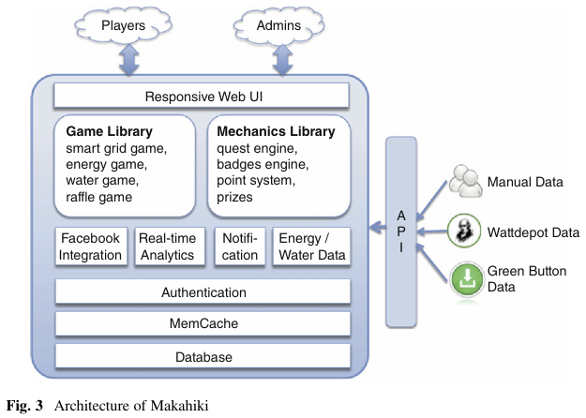
What advancements have been made in cloud-based gamification in education?
Xu et al. Design and Evaluation of the Makahiki Open Source Serious Game Framework for Sustainability Education.
What's been done?
A background review of the problem being solved by the Makahiki game, and other existing solutions to this problem. An overview the system design for Makahiki including the architecture, configurable games and mechanics, real-time analysis, responsive mobile support, and cloud deployment support. Discussion on how others have used/configured the Makahiki framework. An evaluation of the Makahiki framework using the "Serious Game Stakeholder Experience Assessment Model".
Notes:
Background & overview
Bring awareness to the sustainability of water and energy (power) resources and its current state of scarcity
The hope is to do this through the use of a gamified app to teach users about being aware of their consumption and ways to reduce that consumption
Plays on previous water and energy competitions introduced to college dorms and the success they've had
Research had been done for solutions relating to energy behaviour, energy competitions, gamification and using serious games.
Behaviour: energy usage depends on habits, tends to go down if people get feedback or see usage tracking, training can also help
Challenges: competition and visual leaderboards proved to be successful motivators in reducing energy consumption
Gamification: can help make the feedback and content more digestible and meaningful, can encourage participation in energy consumption reduction.
Some examples include:
The Building Dashboard (by Lucid Design Group)
More passive, doesn't really support direct participation/interaction
Focused on energy challenges and reporting like "leaderboards and scores"
Power House
Connects to home smart meter, turns it into multiplayer game for household with challenges and rewards
World Without Oil
focused more on real-world problems as a whole, used to teach students about innovative solutions
Moodle platform limits the game capabilities
Makahiki Game
Provides framework to create serious games for education and behavioural change, focusing on energy, water, food, and waste generation/usage
Started out as a custom-built game for the Energy Competition at University of Hawaii
Included
Real-world and virtual world activities
Real-time energy consumption feedback
Incentives like raffle games and prizes
Version explored in the paper has turned the original into a framework that can be replicated and customized according to the organizations needs
Can extend the framework to include new mini games and modules
Uses HTML5 and CSS3 to accommodate responsive designs (laptops, tablets, phones)
Real-time analytics help assess the impact of game mechanics during challenges
Now supports PaaS facilities like Heroku to solve creation/deployment challenges orgs can face while avoiding obtaining hardware and IT support
Architecture
Players interact with the game, admins monitor the system and input manual data, external real-world date is gathered through the use of APIs
Uses PostgreSQL for the database, and uses Memcache to improve performance
Has 2 libraries of games and game mechanics, and preconfigured widgets for the "internal games" that can be configured or turned on/off
Energy & Water game: tracks energy and water consumption, whether you hit daily targets
Smart Grid Game: grid containing actions/mini challenges. Once completed they grant the user points, and unlock more activities/challenges
Raffle game: players gain raffle tickets as rewards for other game engagement. They can then place their tickets on a desired item, the system randomly chooses a winning ticket at the end of the raffle period
Social & Referral Bonus Game: players gain extra rewards by signing up other players and performing tasks in the Smart Grid Game with other players
Real-time analysis
Used to understand the state of the overall game
Can make resource allocation decisions based on engagement and upcoming challenges
Can be used to make in-game decisions like point values, repetition of tasks related to others that were well received
Responsive support – many students are using phones more often, and so supporting this increases engagement
Cloud deployment
Deployment on the cloud addressed a significant barrier for the creation/usage of gamified apps within education
By removing the need for hardware and IT staff support, the cost are reduced and resources can be used more efficiently
Evaluation
7 HEI created unique instances and tested them with varying total participants ranging from 10 – 1093, and lasting between 2 weeks and 9 months
3 of the institutes chose to locally host, while the other 4 used cloud computing
It's interesting to note that the cloud computing costs for 2 instances that ran for 2 weeks had a large variation ($9 compared to $150)
There were 130 participants for the cheaper one, and 1093 for the more expensive one
Overall, students reported positive impacts on their energy literacy, sustainability awareness, and positive behaviour changes
The successful creation of these customized solutions proves that the framework is a feasible approach to incorporating cloud computing into gamified educational applications
Serious Game Stakeholder Experience Assessment Model
Used to assess the strengths and weaknesses of serious game frameworks with respect to the experiences of different stakeholders within a serious game lifecycle
Includes both quant and qual questions
2 approaches
In-vivo pre-post effectiveness study, in-game surveys, post-hoc interviews
In-vitro for the in-lab experiment instances
Major strengths
Ability to create engaging and effective serious games
Easy to use interfaces for game designers and managers
Weaknesses
Difficulty developing new enhancements to extend the framework from a game developer perspective
Difficulty integrating the framework with external services like LDAP and email servers from a system perspective
Lightweight directory access protocol
Used to access and maintain distributed directory info services over IP network
Lack of WYSIWYG content authoring tool from a game designer perspective
What you see is what you get
A tool to enable designers to create and format content in a visual manner without needing to code

Slide 22
What advancements have been made in cloud-based gamification in education?
Xu et al. Design and Evaluation of the Makahiki Open Source Serious Game Framework for Sustainability Education.
Limitations of the work | Proposed future research
No explicit limitations discussed. OBSERVATION: There were very little details/insight outlining the basic technical set up (cloud computing services, deployment model, cloud computing providers) and how this could be modified across platforms/providers. | Make several improvements to Makahiki framework: Real-time player awareness (who's online), in-game chat capabilities, and adding online multiplayer compatibility. Enhance the Smart Grid Game component by providing a content management system for actions, separating content from the presentation, and adding new content to the library. Development of a variety of organizations to scale the use of the Makahiki framework and developing new content for users outside Hawaaii.

Slide 23
Conclusion and Future Research Directions
There is sufficient research done on educational applications within cloud computing but is lacking with respect to explicit gamification examples and how they're configured.
Many challenges have been highlighted for education service providers, with a focus on socio-economic, budgetary, and humanities-based challenges rather than technical.
There is a lack of research highlighting strong, complete examples of gamified educational applications.
There is a lack of research regarding how gamified educational applications could be/is deployed using the cloud.
Open challenges needing to be addressed in future research:
How could some of the gamified education applications be applied/created within cloud computing systems?
What technical challenges are experienced when adopting cloud computing in education?
What modifications can be made to existing gamified educational applications so they can be easily replicated/customized in the cloud?

Slide 24
References
Agrawal, S. (2021a). A survey on recent applications of Cloud Computing in Education: Covid-19 perspective. Journal of Physics: Conference Series, 1828(1), 1–8. https://doi.org/10.1088/1742-6596/1828/1/012076
AlDuhisat, M. H., AlKhresha, H. G., Al-Dmour, N. A., Ateeq, K., & Maaitah, O. N. (2024). Role of cloud computing in education. 2024 2nd International Conference on Cyber Resilience (ICCR), 1–4. https://doi.org/10.1109/iccr61006.2024.10532895
Anak Bangkong, B. L., Ehsan Rana, M., & Hameed, V. A. (2023). Overcoming the challenges of implementing cloud computing in Higher Education. 2023 4th International Conference on Data Analytics for Business and Industry (ICDABI), 341–346. https://doi.org/10.1109/icdabi60145.2023.10629336
Gollapalli, M., AlQahtani, B., AlGhamdi, A., & AlOtaibi, M. (2023). Instructors experience of using cloud computing based applications in Saudi Arabia. 2023 1st International Conference on Advanced Innovations in Smart Cities (ICAISC), 1–6. https://doi.org/10.1109/icaisc56366.2023.10085435
Kiryakova, G. (2017). Application of cloud services in education. Trakia Journal of Science, 15(4), 277–284. https://doi.org/10.15547/tjs.2017.04.001
Rajan, J., & Wei, N. (2025). Systemic impact of comic-themed gamification on Learner Engagement and retention. 2025 5th International Conference on Artificial Intelligence and Education (ICAIE), 593–596. https://doi.org/10.1109/icaie64856.2025.11158630
Sagale, K. S., Kokate, M. D., & Agrawal, R. K. (2023). Application of cloud computing in an education sector through education and learning as a service and its cost benefit analysis. 2023 International Conference on Emerging Smart Computing and Informatics (ESCI), 1–5. https://doi.org/10.1109/esci56872.2023.10099586
Sandí-Delgado, J. C., Sanz, C. V., & Lovos, E. N. (2022). Acceptance of serious games to develop digital competencies in Higher Education Professors. Electronic Journal of E-Learning, 20(3). https://doi.org/10.34190/ejel.20.3.2181
Tomicic, I., & Schatten, M. (2020). A conceptual network analysis of gamification practices in primary and secondary education. 2020 43rd International Convention on Information, Communication and Electronic Technology (MIPRO), 1091–1097. https://doi.org/10.23919/mipro48935.2020.9245225
Xu, Y., Johnson, P. M., Lee, G. E., Moore, C. A., & Brewer, R. S. (2017). Design and evaluation of the Makahiki Open Source Serious Game Framework for Sustainability Education. Green Energy and Technology, 503–523. https://doi.org/10.1007/978-3-319-57070-9_18
Xuan, C. Z., & Rana, M. E. (2024). Revolutionizing higher education: A critical analysis of cloud computing’s impact, suitability, and challenges. 2024 ASU International Conference in Emerging Technologies for Sustainability and Intelligent Systems (ICETSIS), 733–738. https://doi.org/10.1109/icetsis61505.2024.10459441

